Slide 1
Time Responses

Slide 2
The Transfer Function

Slide 3
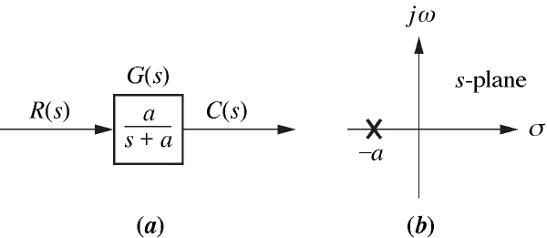
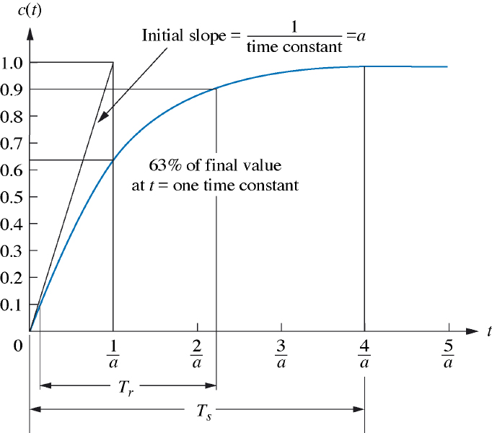
First Order Systems

Slide 5
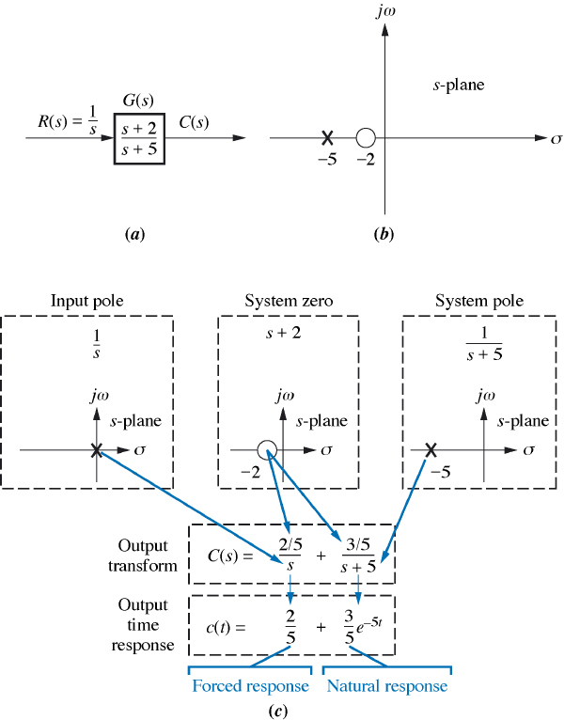
Poles and Zeros of First Order System
Unit step response:

Slide 6
Observations and Conclusions
A pole of the input function generates the form of the forced response (i.e. the pole at the origin generated a step function at the output).
A pole of the transfer function generates the form of the natural response (that is, the pole at -5 generated exp(-5t).
A pole on the real axis generates an exponential response of the form exp(-at) , where -a is the pole location on the real axis. Thus, the farther to the left a pole is on the negative real axis, the faster the exponential transient response will decay to zero (again, the pole at -5 generated exp(-5t).
The zeros and poles generate the amplitudes for both the forced and natural responses (this can be seen from the calculation of A and B in in the previous slide).

Slide 7
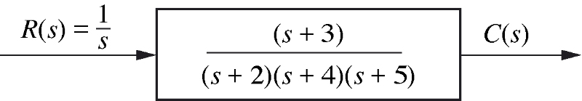
Example: Determine the forced and natural parts of the response to the system
Forced response
Natural response
Forced response
Natural response

Slide 8
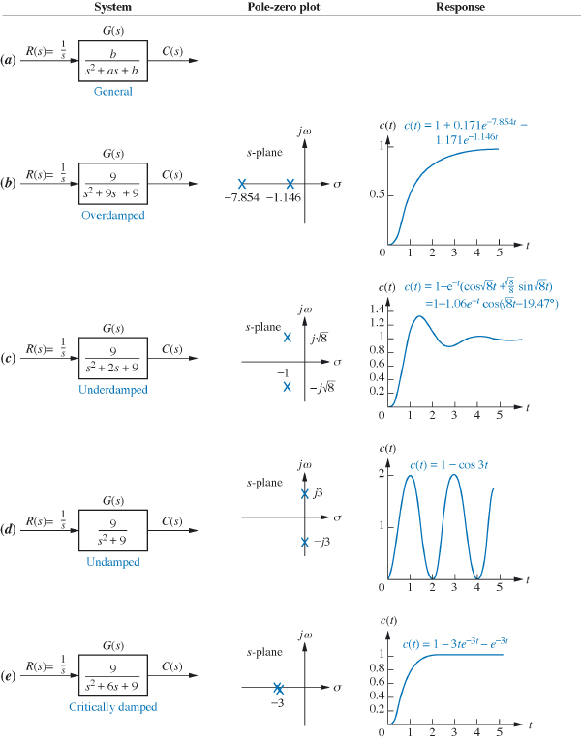
Second order systems

Slide 9
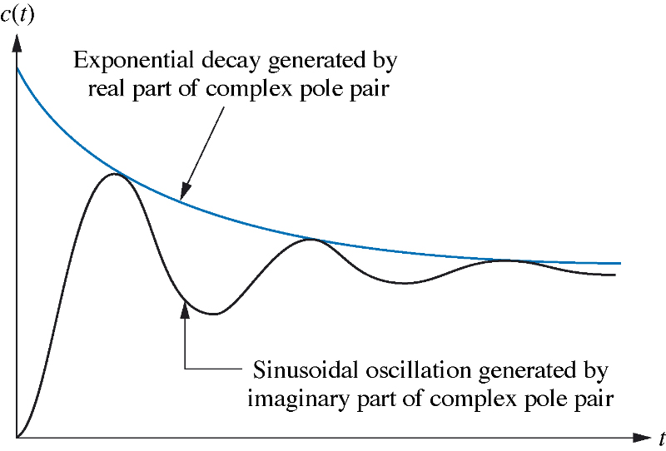
Under-damped response
Second-order step response components generated by complex poles.

Slide 10
Second order systems
1) Over-damped responses: two poles are real:
Natural response:
2) Under-damped responses: two complex poles:
Natural response:
3) Undamped responses: two imaginary poles at:
Natural response:
4) Critically damped responses: two real poles at :
Natural response:

Slide 11
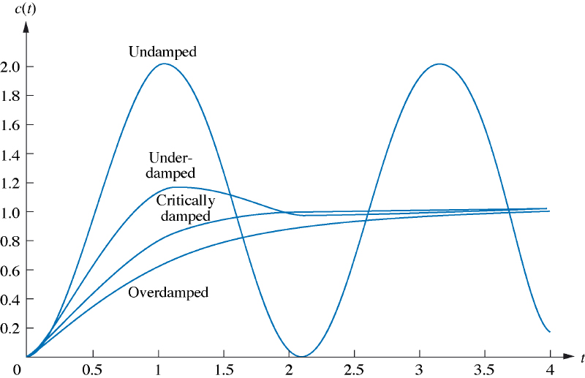
Second order systems responses
Step Response

Slide 12
Time Response of Second Order Systems

Slide 14
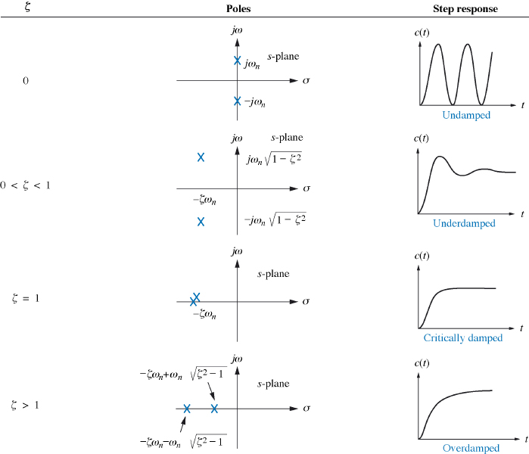
Second order systems responses

Slide 15
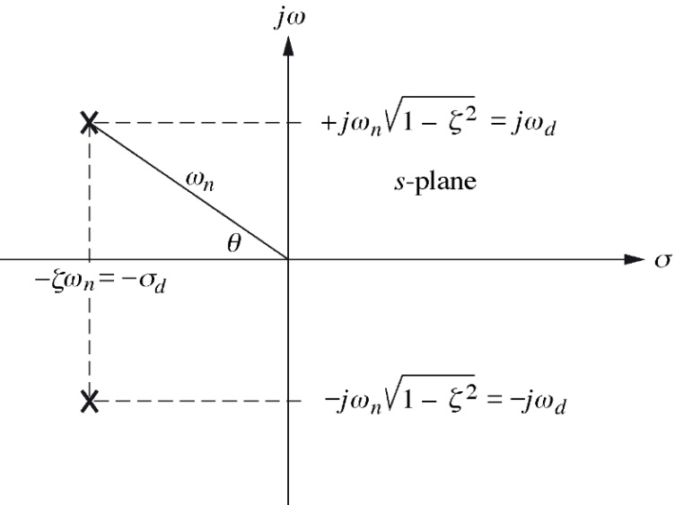
Second order systems

Slide 16
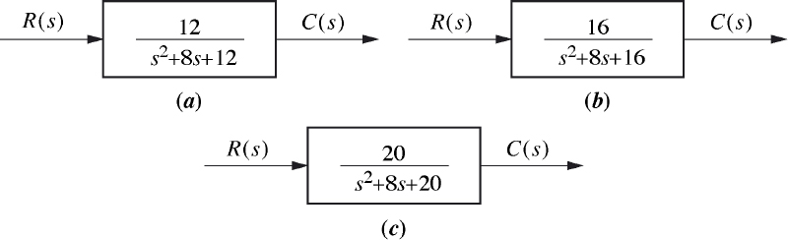
Example: Do exercise 4.4 of the Text Charactering the responses from the value of

Slide 17
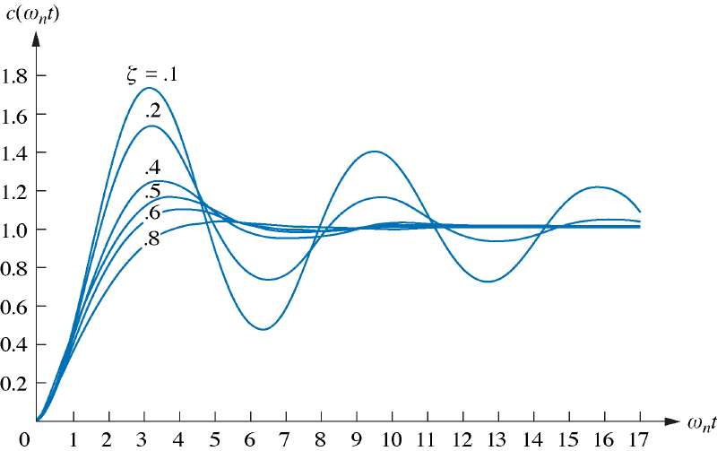
Under-damped second order systems

Slide 18
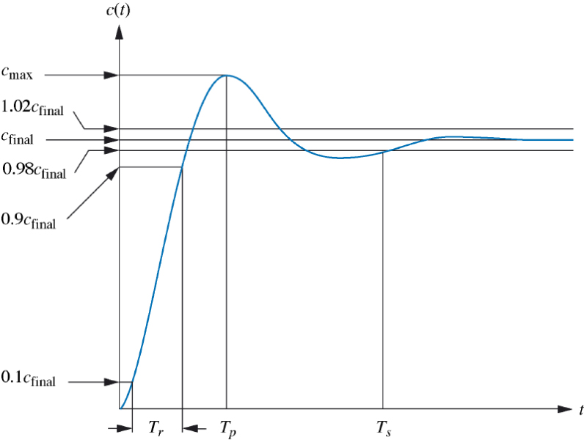
Second-order underdamped response specifications.

Slide 19
1) Rise time, Tr : the time required for the response to go from 0.1 of the final value to 0.9 of the final value.
2) Peak time, Tp : the time required to reach the first, or maximum, peak.
3) Percent overshoot, P.O: the amount that the response overshoots the steady-state,
4) Settling time, Ts : the time required for the transient’s oscillations to reach and stay within 2% of the steady-state value.

Slide 20
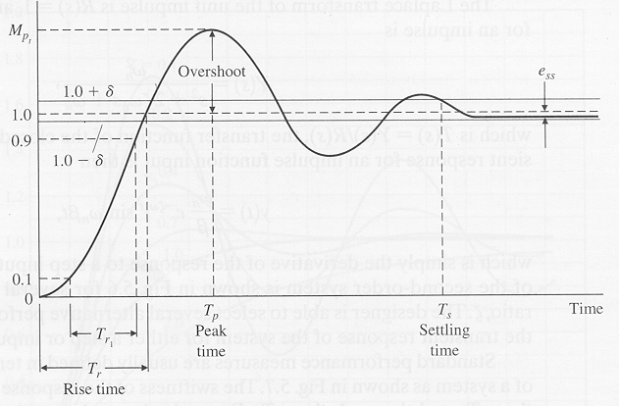
Standard Performance measures
Performance measures are usually defined in terms of the step response of a system as below:
Swiftness of the response is measured by rise time , and peak time
For underdamped system, the Rise time (0 to 100% rise time) is useful,
For overdamped systems, the the Peak time is not defined, and the (10 to 90 % rise time) is normally used
Peak time:
Steady-state error:
Settling time:
Percent of
Overshoot:
is the peak value
is the final value
of the response

Slide 21
Explicit relations for and :
To find we can either differentiate y(t) directly or indirectly through Laplace Transform of y’(t):

Slide 22
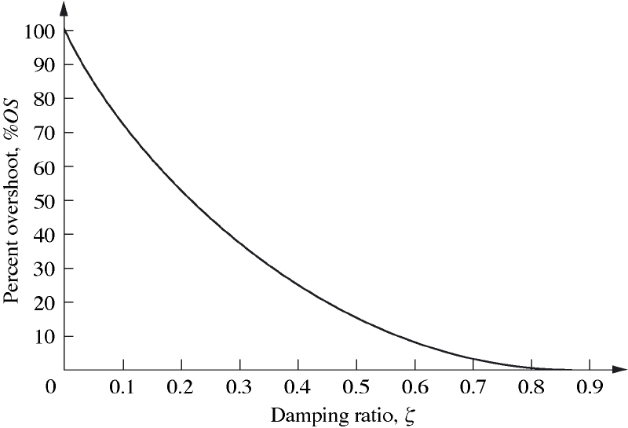
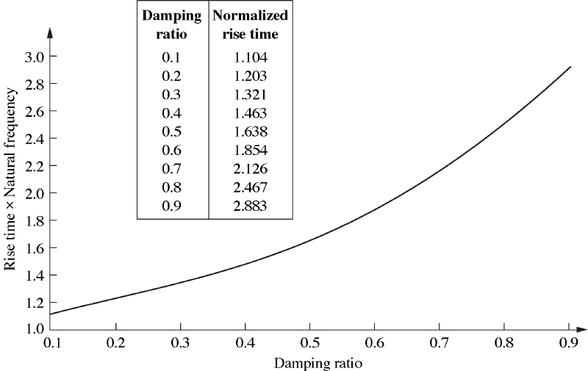

Slide 23

Exercise: Do example 4.5 of the Text
Pole plot for an underdamped second-order system.

Slide 24
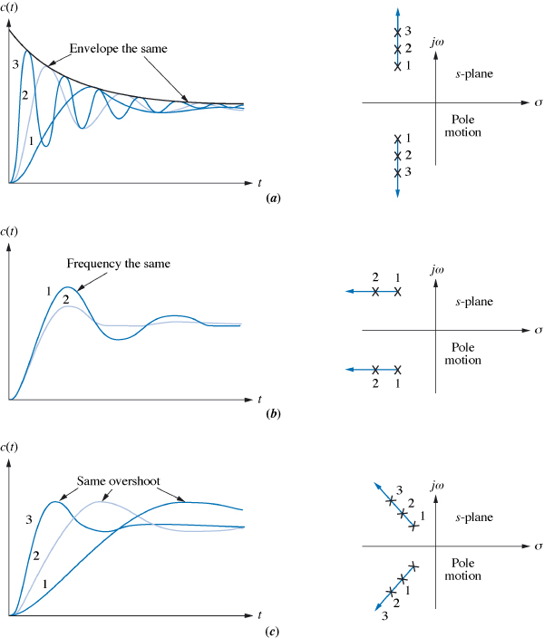

Slide 25
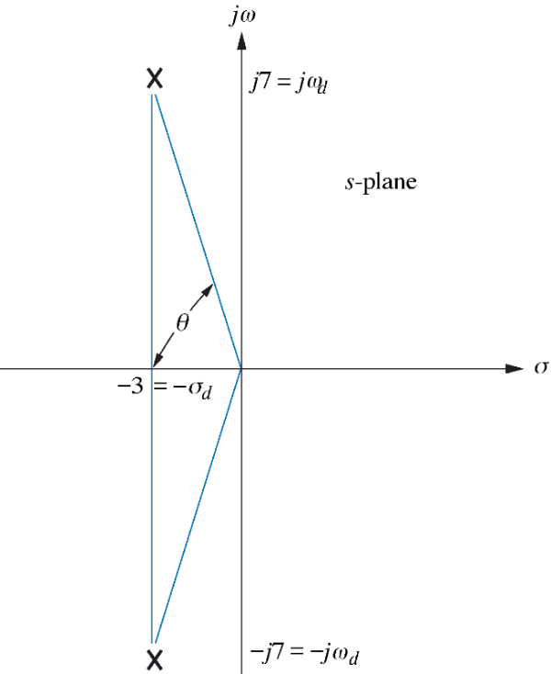
Exercise: Do example 4.6 of the Text
Finding
Tp ,
Ts
and P.O
from the pole location

Slide 26
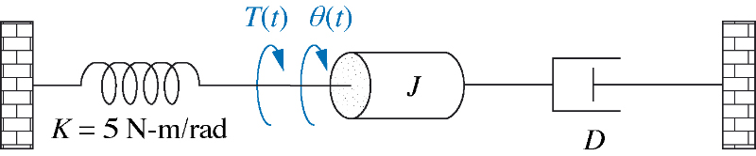
Exercise: Do example 4.7 of the Text
Find J and D so that the percentage overshoot is 20%
and the settling time is 2 seconds.

Slide 27
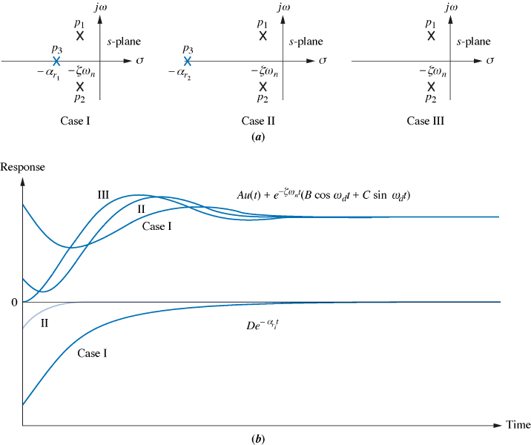
System response with additional poles

Slide 28
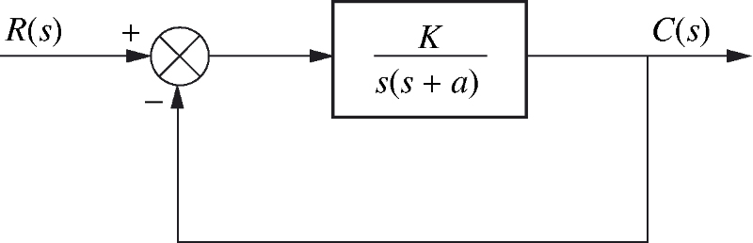
Analysis and design of feedback systems

Slide 29
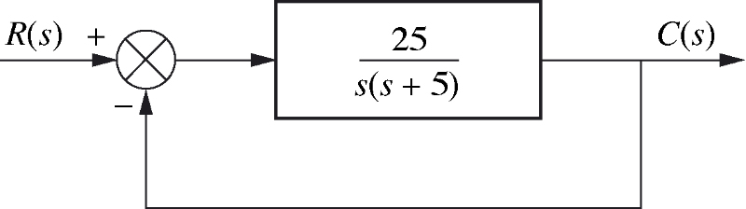
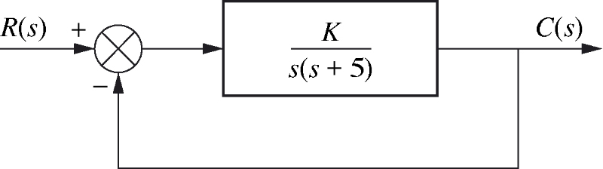
Do examples 5.3 and 5.4 of the Text
Ex. 5.3: Find the peak time, percent overshoot, and settling time.
Ex. 5.4: Design the value of gain K so that the system will respond
with a 10% overshoot.

